Slide 1
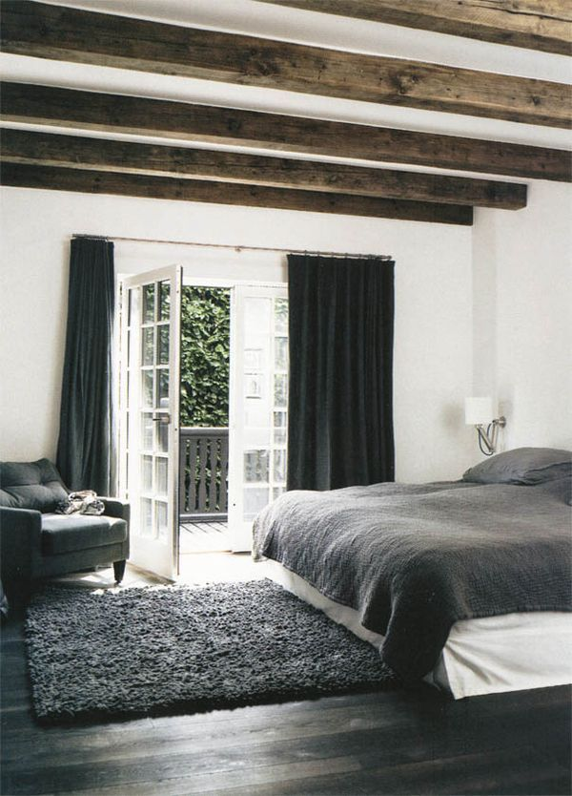
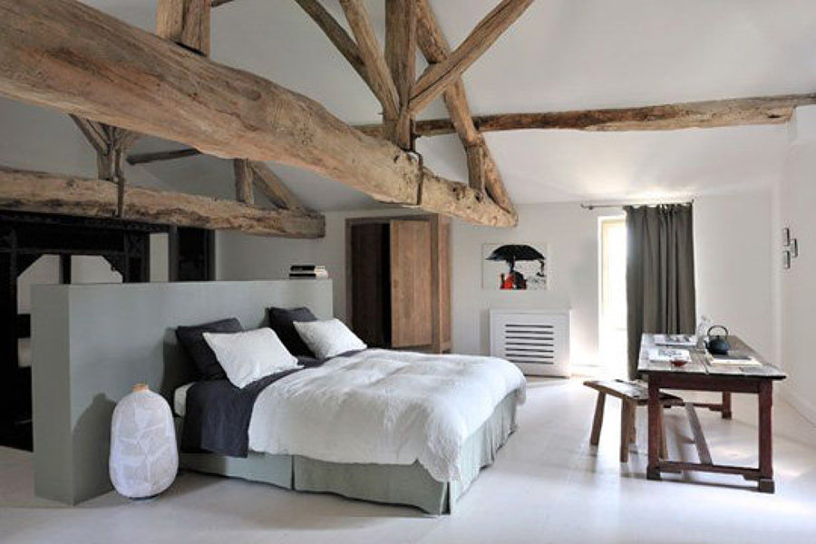
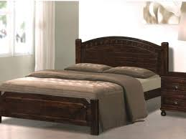
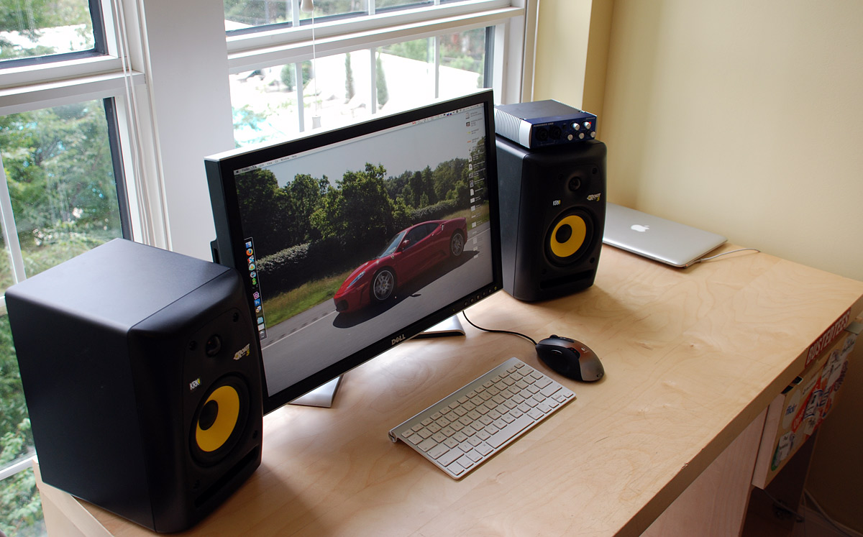
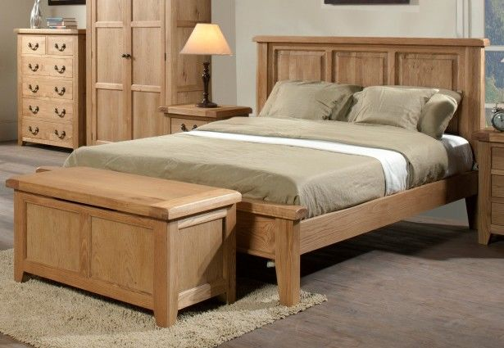
A bed with a wooden frame, curved back board
Another bedroom with the beams exposed, at another angle
A bedroom with the beams exposed, a flat ceiling as described in my interview
Stereo monitors and computer on top of a desk. The ideal setup for the desk model
A bed with a wooden frame, however this has a straight backboard.
Light oak material

